Slide 1
Introduction to
Cloud Computing
By Tech Mahindra Cloud Academy

Slide 2

Agenda : Cloud Computing
Introduction to Cloud Computing
Virtualization and Hypervisors
Cloud Service Models and Types
Cloud Market - Analysis
Q&A
Cloud Pricing
SDN / NFV
Capacity Planning and Cloud Security

Slide 3

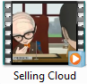
Cloud computing
Selling Cloud Video
Notes:
Start with running the video: “Selling Cloud”. Participant can view other two videos later, which explains virtualization and Cloud Service models.
In this slide Trainer starts this session by running the video “Selling Cloud” and then takes views of the participants on what they know about cloud…

Slide 4
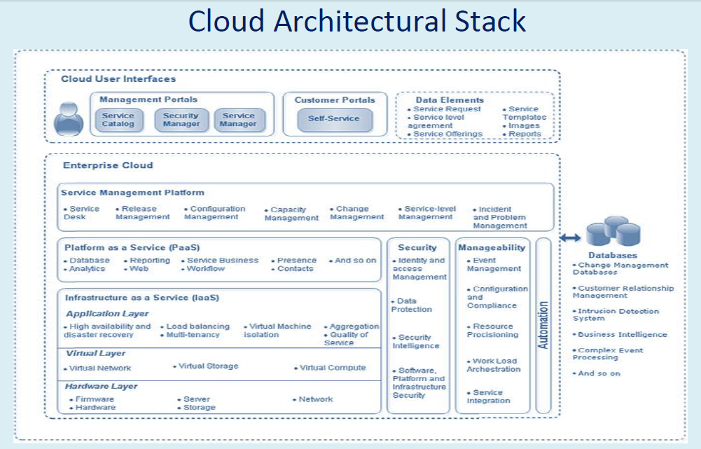

Slide 5
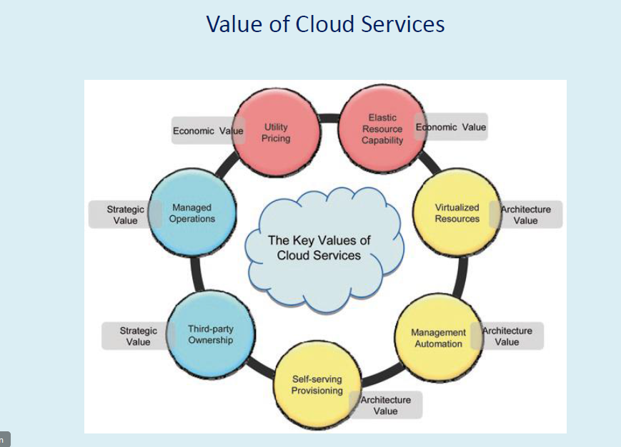

Slide 6



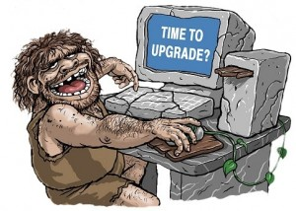


Cloud computing
As an end-consumer, you’ve been using Cloud services for a long time and most of them are free.
Cloud Computing is the delivery of Computing as a Service rather than a Product. It is the generic term used for anything that involves delivering hosted service over the internet.

Slide 7
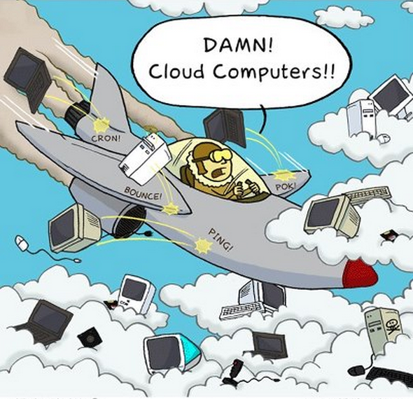
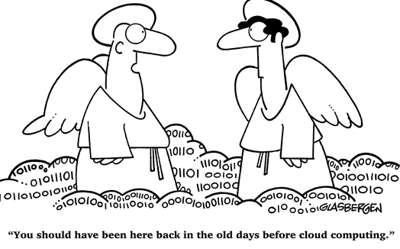
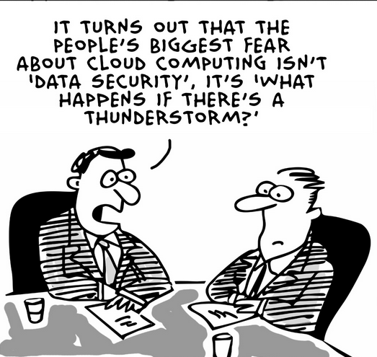
Essential Characteristics of Cloud
On-demand and self-service
Shared resources pooling
Rapid bi-directional elasticity
Measured service
Broad network access
Notes:
‘Broad network access’ implies widespread, heterogeneous network accessibility for thin, thick, mobile and other commonly used compute mediums.
Broad network access includes private clouds that operate within a company’s firewall, public clouds, or a hybrid deployment.

Slide 8

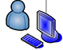
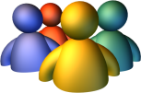
Why is Cloud Computing Important?
Cloud offers value that is different from traditional enterprise IT
Allows to immediately exploit installed hardware and software
Provision and terminate virtual instances at any time
Pay only for the computing resources you use
App1
App2
App3
OS1
OS2
OS3
Hypervisor
Hardware
Virtualized Stack / Cloud Model
Notes:
No Need to design…: This is in case of an SaaS Application, where we just have to use it and pay for the usage
Provision & Terminate…: This saves hassle of Desktop Purchase, they getting Obsolete, replacing those desktop, … Example: WaaS
Pay Only For: If I have to run a campaign for a week in every quarter, I better use SaaS model and save on Time, Money, efforts…

Slide 9
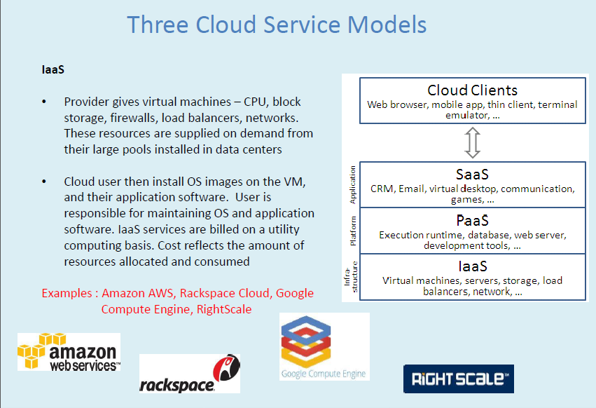

Slide 10
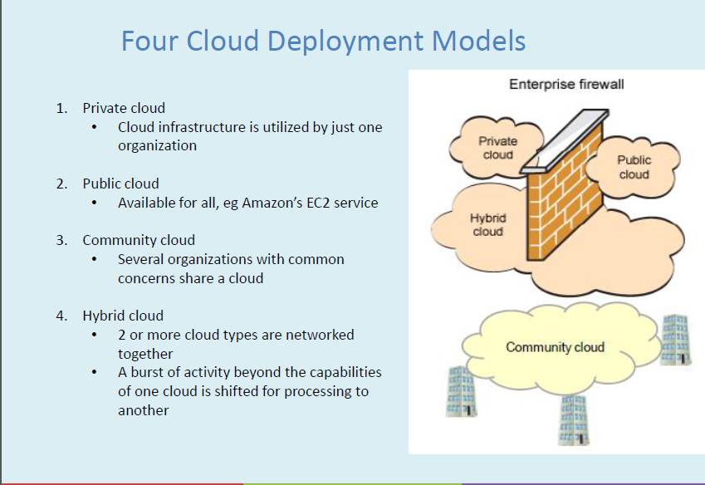

Slide 11
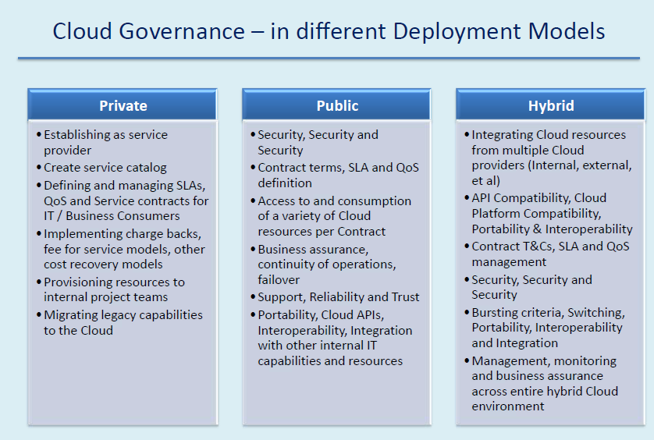

Slide 12
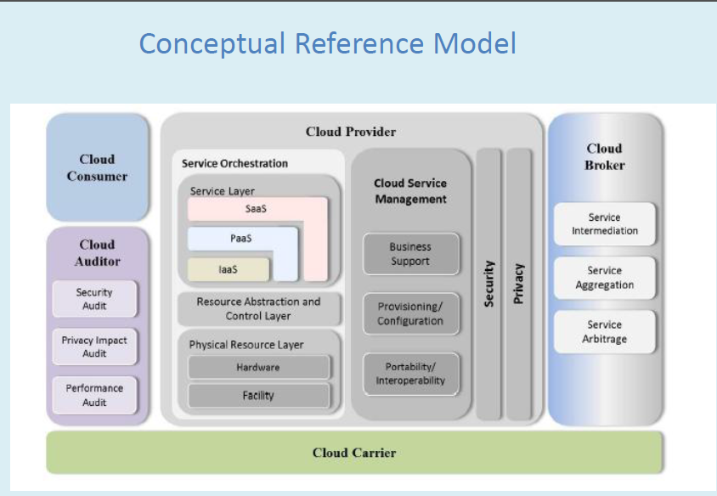

Slide 13
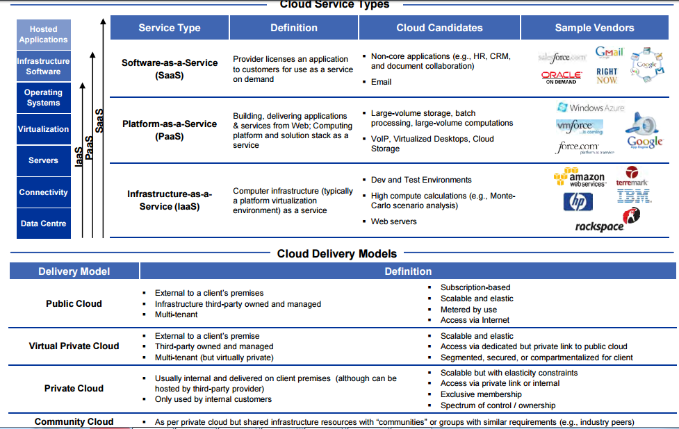

Slide 14
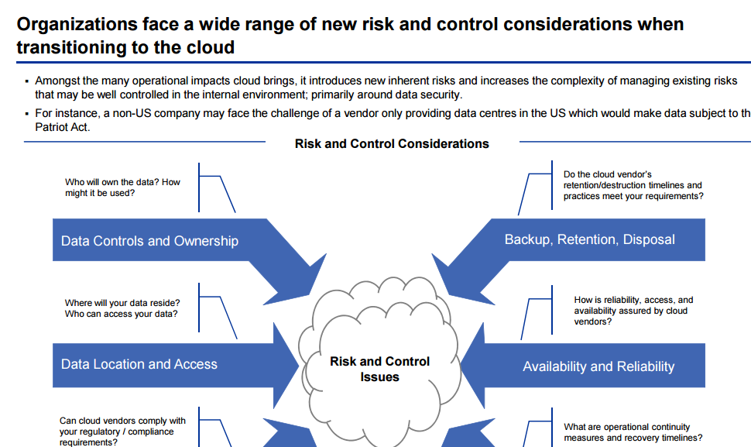

Slide 15
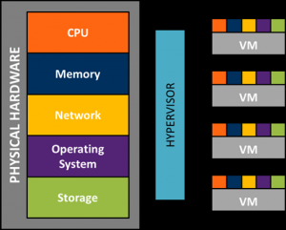
Virtual Machine
A virtual machine is the representation of a physical machine by software.
A virtual Machine has its own set of virtual hardware (e.g., RAM, CPU, NIC, hard disks, etc.) upon which an operating system and applications are loaded.
Virtualization allows multiple virtual machines, with heterogeneous operating systems (e.g., Windows 2003 Server and Linux) and applications to run in isolation, side-by-side on the same physical machine.
Virtualization diagram (Source: Google)
Notes:
Ring 0 is the level with the most privileges and interacts most directly with the physical hardware such as the CPU and memory.

Slide 16
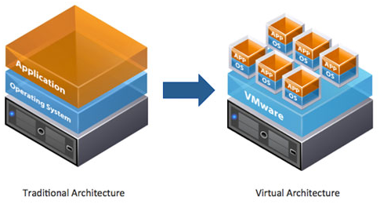
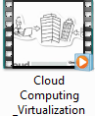
Virtualization
Virtualization is the creation of a virtual (rather than actual) version of something, such as an operating system, a server, a storage device or network resources.
Virtualization layer is a hypervisor running directly on the hardware.
Cloud Virtualization Video Link
Notes:
Traditionally we are aware of Application running on O/S installed on a PC / Server. The limitation is that we cannot run two application needing different environment on the same PC . Virtualization broke that limitaion.

Slide 17
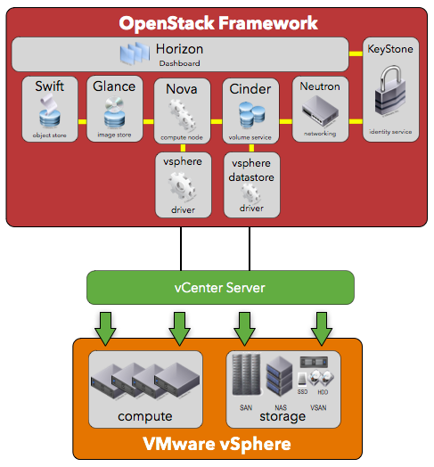
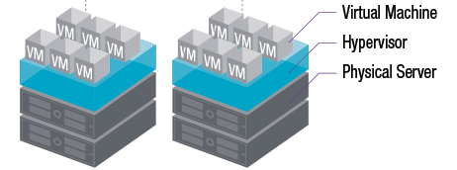
Virtualization and Private Cloud
Virtualization is a critical underlying, or enabling, technology for the Private Cloud.
Virtualization provides benefits in workload provisioning, management and protection. It requires direct support and intervention from IT staff.
A Private Cloud Infrastructure builds on the benefits of virtualization to add new features that reduce reliance on IT staff, including self-service, scalability and chargeback.
Private cloud integrates reporting and chargeback features, which can automatically track computing resource use and bill the VM owners based on their utilization.
Private Cloud
Virtual Machine Management

Slide 18
Private Cloud Deployment
Private Cloud
Cloud Platform
VMware:: vCloud Suite
Microsoft:: System Center
OpenSource:: OpenStack
OpenSource:: CloudStack
Virtual Machine Management
Hypervisor
VMware:: ESXi
Microsoft:: Hyper-V
Oracle:: VirtualBox
OpenSource:: KVM ,
Citrix:: Xen Server

Slide 19
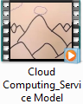
Cloud Service Models
Infrastructure as a Service
Provisioning model in which an organization outsources the equipment used to support operations including storage, hardware, services and networking components.
Platform as a Service
Completely managed Cloud computing environment into which you deploy and run your applications
Software as a Service
Software distribution model in which applications are hosted by a vendor or service provider and made available to customers over the Internet
Cloud Service Model Video

Slide 20
Cloud Stack: IaaS / PaaS / SaaS Comparison
Traditional
(On-Premises)
Infrastructure as a Service (IaaS)
Platform as a Service (PaaS)
Software as a Service (SaaS)
Applications
Applications
Applications
Applications
You Manage
Development & Runtime Kernels
Development & Runtime Kernels
Development & Runtime Kernels
Development & Runtime Kernels
Databases
You Manage
Databases
Databases
Databases
Security, Management, Load Balancing & Integration
Security, Management, Load Balancing & Integration
Security, Management, Load Balancing & Integration
Security, Management, Load Balancing & Integration
Operating System
Operating System
Operating System
Operating System
You Manage
Managed by Vendor
Virtualization
Virtualization
Managed by Vendor
Virtualization
Virtualization
Storage
Storage
Storage
Storage
Managed by Vendor
Server Hardware
Server Hardware
Server Hardware
Server Hardware
Networking, Utilities, Physical
Networking, Utilities, Physical
Networking, Utilities, Physical
Networking, Utilities, Physical
Control + Cost
Efficiency + Savings

Slide 21
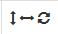
PaaS Runtime Comparison
Name | Runtimes | Scaling | Geo Locations
Amazon Elastic Beanstalk | dotnet ,go, java, php ,python ruby |  | AS EU NA OC SA
Apprenda | Docker, dotnet, java extensible
Bluemix | go java node php python ruby extensible |  | EU NA
Cloud Foundry | go groovy java node php python ruby scala extensible
Force.com | apex |  | AS EU NA
Google App Engine | go java php python |  | EU NA
Microsoft Azure | dotnet java node php python ruby extensible |  | AS EU NA OC SA
OpenShift Enterprise | java node perl php python ruby extensible
Pivotal CF | go groovy java node php python ruby scala extensible
AS- Asia, EU – Europe, NA / SA – North / South America, OC - Oceania
Vertical, Horizontal & Auto of one or both directions

Slide 22
Cloud Deployment Models
IT activities / functions are provided “as a service,” over the Internet.
IT capabilities provided “as a service,” over an intranet, within enterprise and behind the firewall.
Internal and external service delivery methods are integrated.
Several organizations with common concerns share a Cloud.

Slide 23
Cloud Adoption Trends

Slide 24
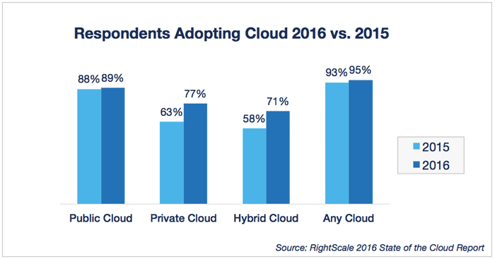
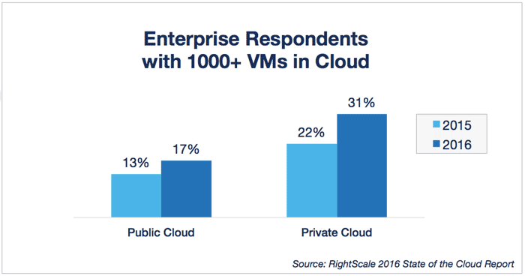
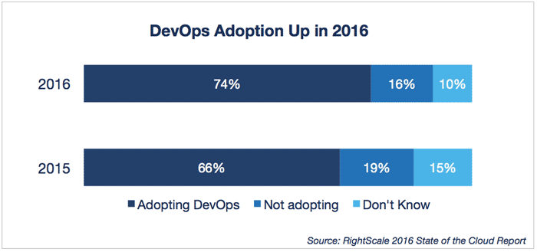
Cloud Adoption Trends
Rightscale Cloud Management Survey Report

Slide 25
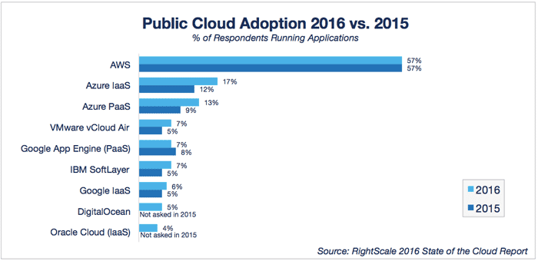
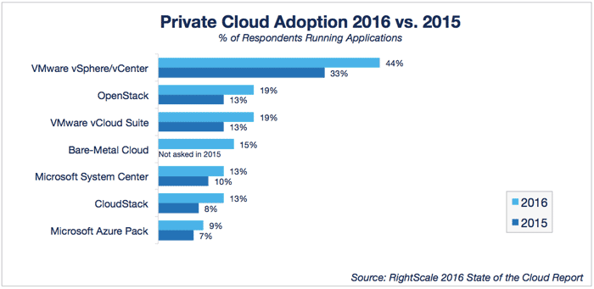
Cloud Adoption Trends

Slide 26
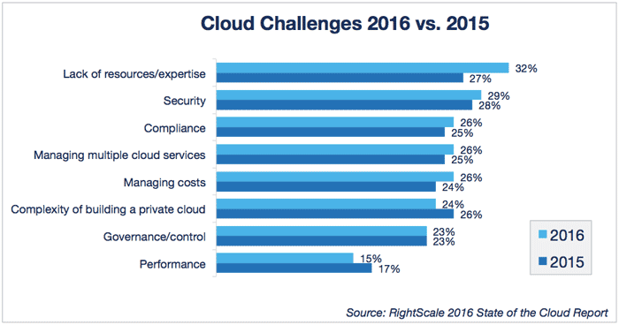
Challenges in Cloud Adoption

Slide 27
SDN and NFV

Slide 28
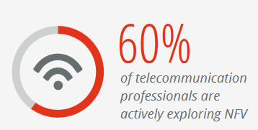
NFV and SDN
NFV and SDN compliments each other but solves different problems in different environment across various domains.
NFV | SDN
NFV aimed at accelerating service innovation and provisioning using standard IT virtualization technologies. | SDN emerged to make network devices programmable and controllable from a central element.
NFV typically involves moving networking applications to virtual machines or containers that run on commodity hardware. | SDN requires new interfaces, control modules, and applications
$10.65 billion growth in the global NFV hardware, software and services market.

Slide 29
NFV
Network Function Virtualization (NFV) is the virtualization of network functions by implementing these functions in software and running them on VMs.
NFV decouples network functions, such as Network Address Translation (NAT), firewalling, intrusion detection, Domain Name Service (DNS), and caching, from proprietary hardware appliances so that they can run in software on VMs.

Slide 30
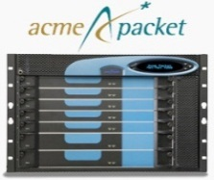
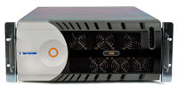
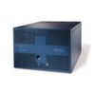
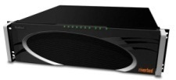
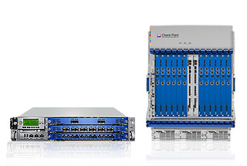
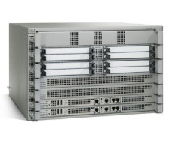
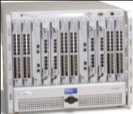
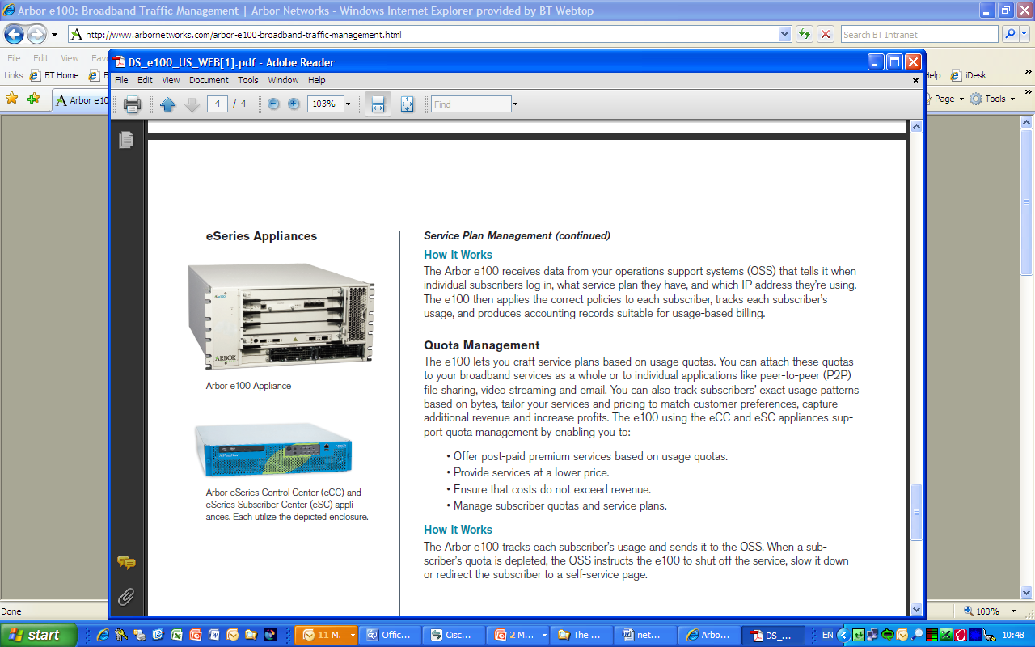
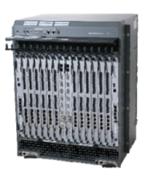
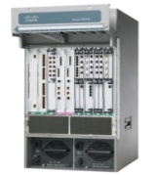
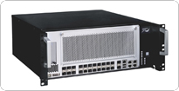
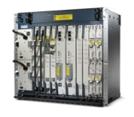
Traditional Approach
Down
High CAPEx and OPEx
High Power and Energy
Service Innovation is challenging
Purpose specific ASIC hardware
Weak Administration
Development lifecycle – Nightmare
Physical Appliance per appliance per site
UP
Efficiency/Performance because logic in HARDWARE
Classical Network Appliance Approach
Message
Router
CDN
Session Border
Controller
WAN
Acceleration
DPI
Firewall
Carrier Grade NAT
Tester/QoE
monitor
SGSN/GGSN
PE Router
BRAS
Radio Access Network Nodes
Fragmented non-commodity hardware.
Physical install per appliance per site.
Hardware development large barrier to entry for new vendors, constraining innovation & competition.
Notes:
Source: Network Functions Virtualisation – Introductory White Paper, http://portal.etsi.org/NFV/NFV_White_Paper.pdf

Slide 31
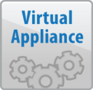

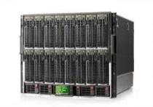
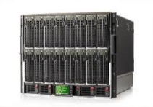
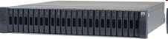
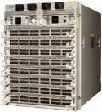
The NFV Concept
Independent Software Vendors
Classical Network Appliance Approach
Message
Router
CDN
Session Border
Controller
WAN
Acceleration
Orchestrated,
automatic &
remote install.
A means to make the network more flexible and simple by minimising dependence on HW constraints
DPI
Firewall
Carrier Grade NAT
Tester/QoE
monitor
Standard High Volume Servers
Standard High Volume Storage
SGSN/GGSN
PE Router
BRAS
Radio Access Network Nodes
Standard High Volume
Ethernet Switches
Fragmented non-commodity hardware.
Physical install per appliance per site.
Hardware development large barrier to entry for new vendors, constraining innovation & competition.
Network Virtualisation Approach
Notes:
Source: Network Functions Virtualisation – Introductory White Paper, http://portal.etsi.org/NFV/NFV_White_Paper.pdf

Slide 32
The NFV Concept
Independent Software Vendors
DPI
Firewall
Routing
Proxy
Orchestrated,
automatic &
remote install.
VM
VM
VM
VM
Standard High Volume Servers
Hypervisor
Standard High Volume Storage
Commodity X86 Hardware
Standard High Volume
Ethernet Switches
Network Virtualisation Approach
Notes:
Source: Network Functions Virtualisation – Introductory White Paper, http://portal.etsi.org/NFV/NFV_White_Paper.pdf

Slide 33
Network Virtualization
Network functions that can be virtualized are
Routing
Policy management
Security
Traffic Management
Load balancing
QoS
Network Address Translation
Device Management
Media Streaming
Identity Management

Slide 34
Security in The Cloud

Slide 35

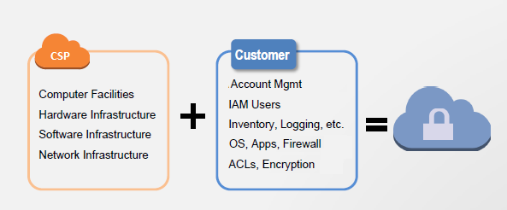
Shared Responsibility Security Model
The Shared Responsibility Security Model
Cloud Service Provider’s role in security
Subscriber / User’s role in security
Securing networks with security groups
Notes:
Identity and access management (IAM) is the security discipline that enables the right individuals to access the right resources at the right times for the right reasons.

Slide 36
CSP & Customer Responsibility
CSP responsible for securing:
Customer is responsible for securing:
Physical security
Physical infrastructure
Network infrastructure
Virtualization infrastructure
Third-Party attestations, reports, and certifications for the above
Operating system
Application
Security groups
OS firewalls
Network configuration
Account management
Certifying their applications

Slide 37
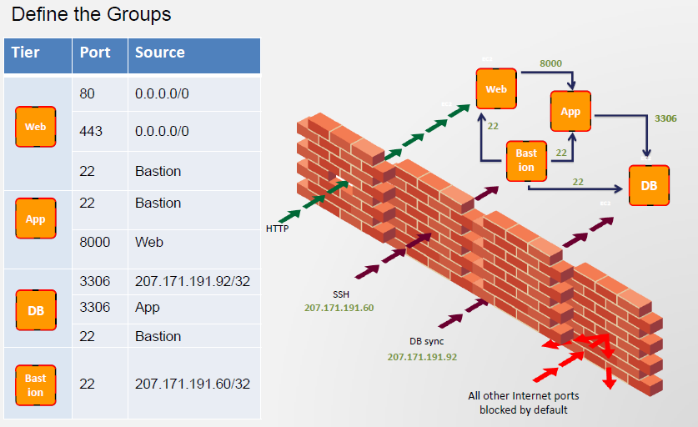
Securing Networks with Security Groups
Notes:
On the Internet, a bastion host is the only host computer that a company allows to be addressed directly from the public network and that is designed to screen the rest of its network from security exposure.

Slide 38
DevOps

Slide 39
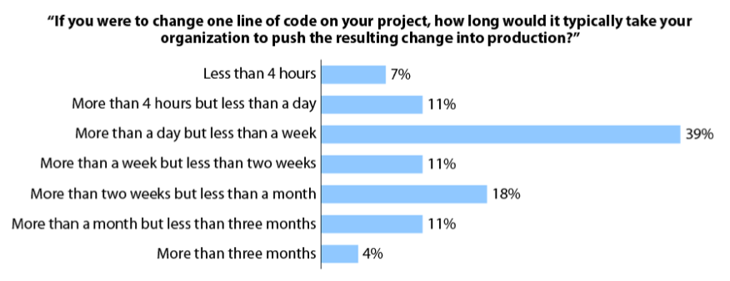
How Responsive is your Organization?
Source: Forrester Research Inc., “Five Ways To Streamline Release Management”

Slide 40
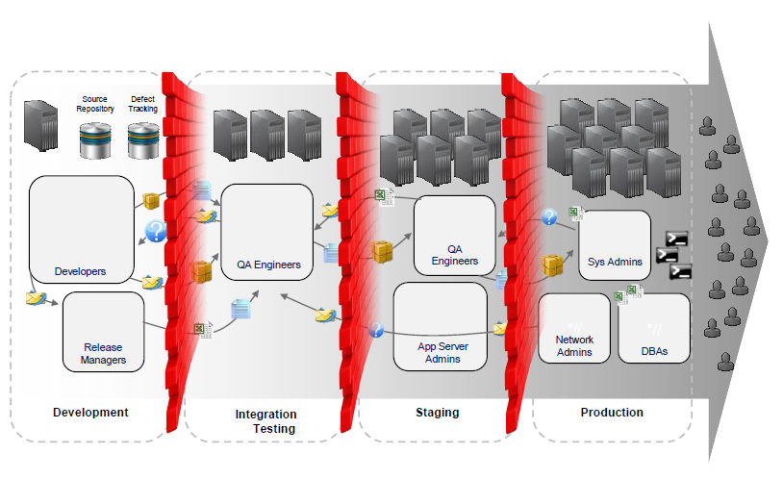

Software Delivery Challenges
Work organized in silos has run its course
Long Release Times
Release bottlenecks (can’t make release window) delays & limited operational agility.
60%
Release Failures
60% of application failure & downtime is release related.
(IDC Survey 2009)
High Costs
75% of IT operation team’s time is spent on release management.
(Forrester, 2009)
Lack of collaboration and absence of continuous Integration

Slide 41


What is DevOps
The term DevOps is a blend of Development (representing software developers, including programmers, testers, and quality assurance personnel) and Operations (representing the experts who put software into production and manage the production infrastructure, including system administrators, database administrators, and network technicians).

Slide 42


Blame Game: Dev vs. Ops

Slide 43
DevOps addresses the challenge
DevOps typically refers to the emerging professional movement that advocates a collaborative working relationship between Development and IT Operations.
DevOps encompasses numerous activities and aspects, such as the following:
Culture: People over processes and tools. Software is made by and for people.
Automation: Automation is essential for DevOps to gain quick feedback
Measurement: DevOps ﬁnds a speciﬁc path to measurement. Quality and shared (or at least aligned) incentives are critical.
Sharing: Creates a culture where people share ideas, processes, and tools.

Slide 44





Demystifying DevOps
DevOps Lifecycle
Business Owners
Development/ Test
Operations/ Production
Customers
Continuous Innovation, Feedback and Improvements
Delivering continuous value without barriers
Business Planning
Project & Release Planning
Requirement Management
Design & Develop
Build & CI
Testing
Release control & Change Management
Operation & Monitoring
Continuous Planning
Continuous Integration
Continuous Testing
Continuous Deployment
Continuous Monitoring

Slide 45
Thank you
Visit us at www.techmahindra.com

Slide 46


Slide 47
Thank You
www.techmahindra.com

Slide 48
Backup Slides

Slide 49

We are creating a Hybrid cloud by connecting our Vmware based Private Cloud with AWS , HP and Azure Public Cloud
Hybrid Cloud Setup
Notes:
(StasS, Verticalised solutions, MAC (Cast Iron, RSA)) AOB, Public cloud access, Lab Enablement, training enablement

Slide 50



TechM Cloud Data Center Setup
CLOUD CEc
Total Servers: 15 (9 Blades + 6 Rack Mount)
Centralized Storage ~5 TB
Total Compute: 39.48 GHz
Total Physical Memory: 768 GB Cloud Data center
Open Stack
VMware VSphere
VMware VSphere
IBM SCO
KVM Hypervisor
VMware ESXI 5.0
VMware ESXI 5.5
VMware ESXI 5.1

Slide 51

Type 1 and Type 2 Hypervisors (1of 2)
App1
App2
App3
TYPE 1 Hypervisor runs directly on the hardware. | Type 2 Hypervisor runs directly on another OS, such as Linux / Windows.
Examples: Citrix Xen Server, KVM, VMware ESX / ESXi, Microsoft Hyper-V, IBM PowerVM | Examples: VMware Workstation, Sun’s VirtualBox
OS1
OS2
OS3
Hypervisor
Hardware

Slide 52

Docker and virtualization
Docker is not a hypervisor. It’s neither a replacement for Hypervisor nor for VDI.
Docker uses Linux containers to make virtualization deployments easier to manage and scale.
Docker bolts containers onto a base OS. It shares parts of the core OS, but keeps each container isolated.

Slide 53

Docker and virtualization
Use Containers When:
We want to get most server application instances running on the least amount of hardware.
We want multiple copies of the same application.
Docker is an open-source technology. They are much more efficient than hypervisors in system resource terms.
Instead of virtualizing hardware, containers rest on top of a single Linux instance.
With a perfectly tuned container system, we can have four-to-six times the number of server application instances as we can using VMs on the same hardware.
One thing hypervisors can do that containers can’t is to use different operating systems or kernels.

Slide 54

Goals and Divergent
DevOps
Try to Rationalize
Service oriented
STABILITY
Deliver New Feature( of good quality)
Product Oriented
Try to Innovate
WALL OF CONFUSION
Automation
Continuous Delivery
Collaboration
Extreme Focus on Functionality change
Extreme Focus on Stability
BUSINESS
REQUIREMENTS
BOTH

